Slide 1


ToT-Prompt Optimization for LLM-based Automatic Summarization
Reporter: Zhao Zhao Xiaoqi Qiu
Date: 2025/12/10
Notes:
Goodmorning, everyone, my nane is Xiaoqi Qiu. Today i wanna talk about the future of transportation.

Slide 2


01
Introduction
03
Method Design
- Desigin Rationals
- Method
A brief introduction to this problem
02
Formulization
- Math Modeling
- Complexity
04
Experiments
- Dataset
- Results
CATALOGUE
CATALOGUE

Slide 3


01
Introduction

Slide 4
Introduction
📌 Core Problem
Select and arrange prompt words, maximize the quality of summaries generated by LLMs
🔍 Problem Nature
Combinatorial Optimization Problem
Huge Search Space: n components → O(n!) possible permutations and combinations
High Evaluation Cost
Notes:
https://mashable.com/feature/faster-than-light-space-interstellar-travel just Think about it: how many times have you been stuck in traffic wishing you could just teleport to your destination.
Actually we're on the verge of a transportation Revolution.
Now, Let’s take a look at technologies shaping our future transportation

Slide 5
Introduction
🌍 Practical Application Background
Financial Analysis:
Efficiently process financial news, corporate reports
Scientific Research:
Accelerating knowledge extraction and integration
Law & Healthcare:
Quickly condense legal cases, generate medical record summaries
Notes:
https://mashable.com/feature/faster-than-light-space-interstellar-travel just Think about it: how many times have you been stuck in traffic wishing you could just teleport to your destination.
Actually we're on the verge of a transportation Revolution.
Now, Let’s take a look at technologies shaping our future transportation

Slide 6
02
Formulization

Slide 7
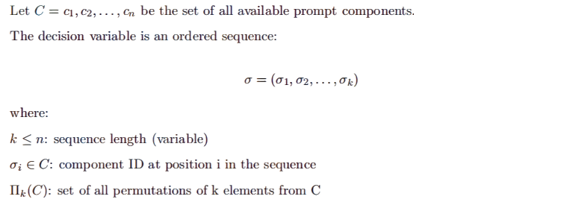

Formalization of the Problem
Find an optimal ordered sequence from n prompt components within a limited evaluation budget.
Maximize: $Q(σ)$
where $Q(σ)=f_{comp}(σ)+f_{order}(σ)−p(σ)$ Component Base Score, Order Synergy Effect, Penalty Terms
Decision variables: $σ=(σ_{1},σ_{2},...,σ_{k})∈Π_{k}(C)$
Notes:
https://mashable.com/feature/faster-than-light-space-interstellar-travel just Think about it: how many times have you been stuck in traffic wishing you could just teleport to your destination.
Actually we're on the verge of a transportation Revolution.
Now, Let’s take a look at technologies shaping our future transportation

Slide 8
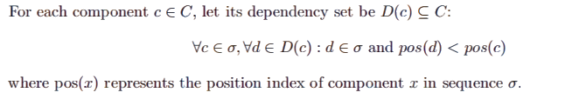
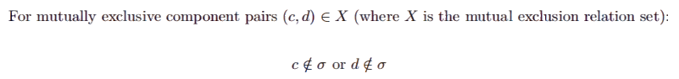
Constraints
1. Dependency Constraints
2. Mutual Exclusion Constraints
Notes:
https://mashable.com/feature/faster-than-light-space-interstellar-travel just Think about it: how many times have you been stuck in traffic wishing you could just teleport to your destination.
Actually we're on the verge of a transportation Revolution.
Now, Let’s take a look at technologies shaping our future transportation

Slide 9
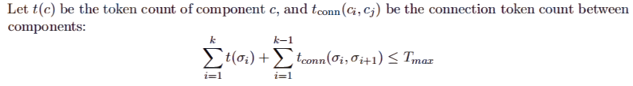
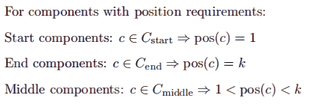
Constraints
3. Length Constraints
4. Position Constraints
Notes:
https://mashable.com/feature/faster-than-light-space-interstellar-travel just Think about it: how many times have you been stuck in traffic wishing you could just teleport to your destination.
Actually we're on the verge of a transportation Revolution.
Now, Let’s take a look at technologies shaping our future transportation

Slide 10
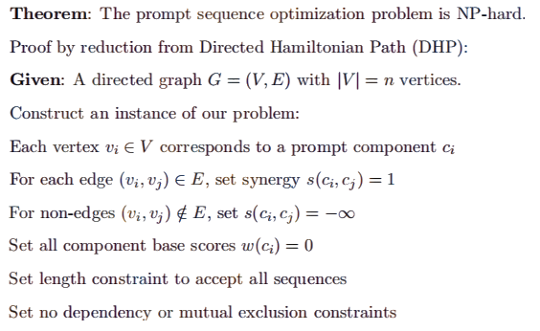
NP-Hard Proof
Notes:
https://mashable.com/feature/faster-than-light-space-interstellar-travel just Think about it: how many times have you been stuck in traffic wishing you could just teleport to your destination.
Actually we're on the verge of a transportation Revolution.
Now, Let’s take a look at technologies shaping our future transportation

Slide 11
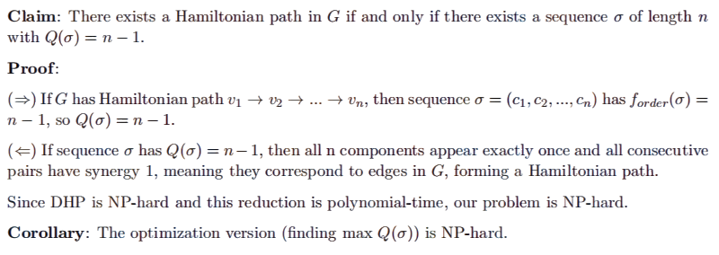
NP-Hard Proof
Notes:
https://mashable.com/feature/faster-than-light-space-interstellar-travel just Think about it: how many times have you been stuck in traffic wishing you could just teleport to your destination.
Actually we're on the verge of a transportation Revolution.
Now, Let’s take a look at technologies shaping our future transportation

Slide 12
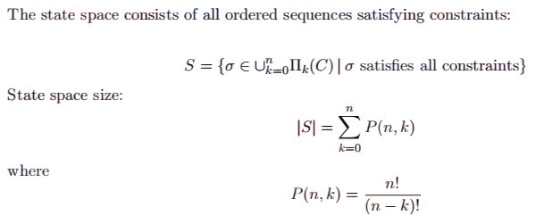
State Space Complexity
Search Space
Notes:
https://mashable.com/feature/faster-than-light-space-interstellar-travel just Think about it: how many times have you been stuck in traffic wishing you could just teleport to your destination.
Actually we're on the verge of a transportation Revolution.
Now, Let’s take a look at technologies shaping our future transportation

Slide 13
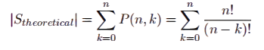
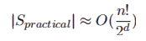

State Space Complexity
Theoretical Upper Bound
Asymptotic complexity: $O(n!)$
Practical
Notes:
https://mashable.com/feature/faster-than-light-space-interstellar-travel just Think about it: how many times have you been stuck in traffic wishing you could just teleport to your destination.
Actually we're on the verge of a transportation Revolution.
Now, Let’s take a look at technologies shaping our future transportation

Slide 14
03
Method Design：ToT Prompt Optimizer

Slide 15
Design Rationale
Why heuristic solution?
Problem: Prompt optimization is a High-Dimensional, Discrete Combinatorial Optimization problem.
Notes:
https://mashable.com/feature/faster-than-light-space-interstellar-travel just Think about it: how many times have you been stuck in traffic wishing you could just teleport to your destination.
Actually we're on the verge of a transportation Revolution.
Now, Let’s take a look at technologies shaping our future transportation

Slide 16
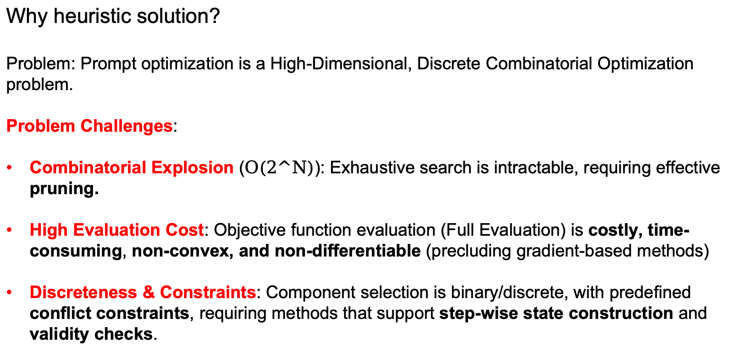
Design Rationale
Why heuristic solution?
Problem: Prompt optimization is a High-Dimensional, Discrete Combinatorial Optimization problem.
Problem Challenges:
Combinatorial Explosion ($O(2^N)$): Exhaustive search is intractable, requiring effective pruning.
High Evaluation Cost: Objective function evaluation (Full Evaluation) is costly, time-consuming, non-convex, and non-differentiable (precluding gradient-based methods)
Discreteness & Constraints: Component selection is binary/discrete, with predefined conflict constraints, requiring methods that support step-wise state construction and validity checks.

Slide 17
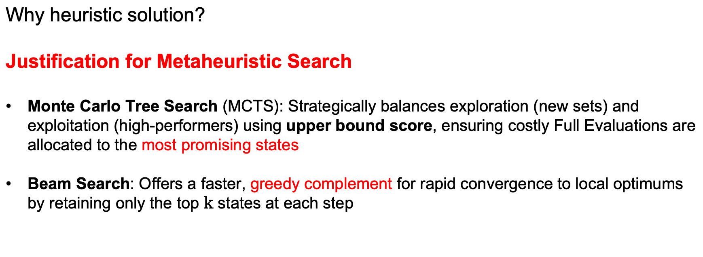
Design Rationale
Why heuristic solution?
Justification for Metaheuristic Search
Monte Carlo Tree Search (MCTS): Strategically balances exploration (new sets) and exploitation (high-performers) using upper bound score, ensuring costly Full Evaluations are allocated to the most promising states
Beam Search: Offers a faster, greedy complement for rapid convergence to local optimums by retaining only the top $k$ states at each step
Key Feature: Learning-to-Optimize (L2O): Incorporates a lightweight Heuristic Evaluation (predictive assessment) to guide the search.

Slide 18
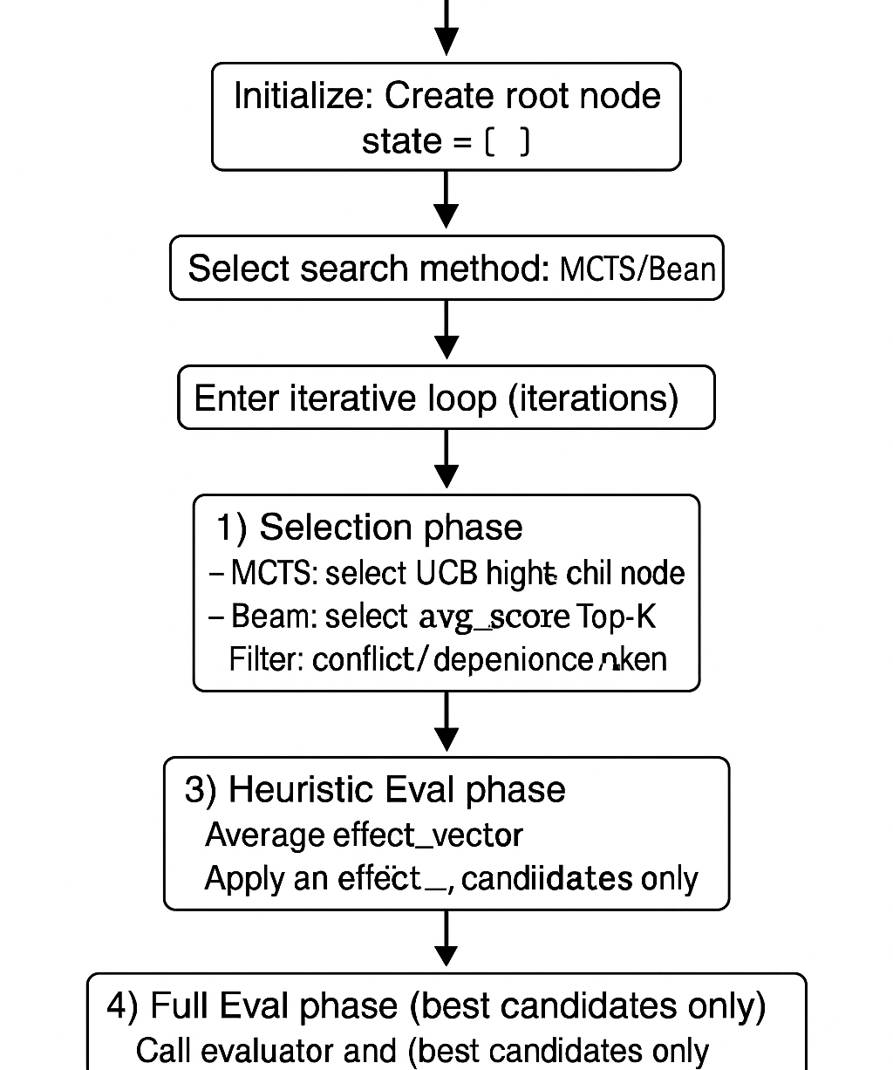

ToT Prompt Optimizer
Notes:
The first one is integrated smart sustems. Imagine you wake up in the morning， AI will soon plan our entire day — from when to leave to which route is cleanest and fastest — making mobility both smart and sustainable

Slide 19
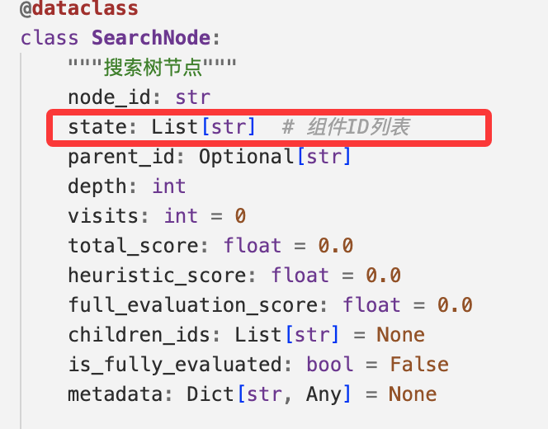
ToT Prompt Optimizer
Core Structure and State Representation
State: A valid set of Prompt components.
Node: A position within the search tree, storing a state S and search statistics.
Notes:
The first one is integrated smart sustems. Imagine you wake up in the morning， AI will soon plan our entire day — from when to leave to which route is cleanest and fastest — making mobility both smart and sustainable

Slide 20
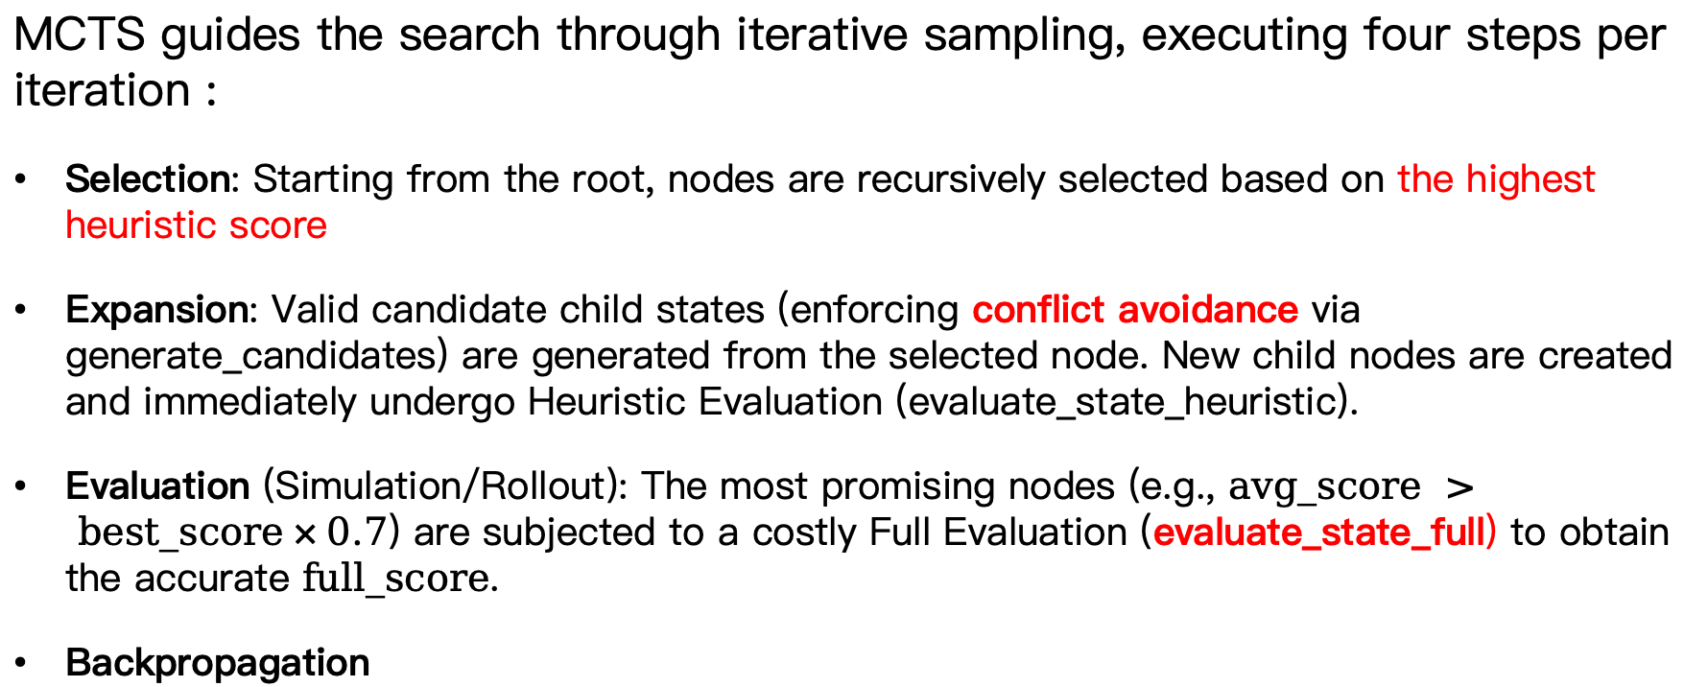
Monte Carlo Tree Search (MCTS)
MCTS guides the search through iterative sampling, executing four steps per iteration :
Selection: Starting from the root, nodes are recursively selected based on the highest heuristic score
Expansion: Valid candidate child states (enforcing conflict avoidance via generate_candidates) are generated from the selected node. New child nodes are created and immediately undergo Heuristic Evaluation (evaluate_state_heuristic).
Evaluation (Simulation/Rollout): The most promising nodes (e.g., $avg_score > best_score×0.7$) are subjected to a costly Full Evaluation (evaluate_state_full) to obtain the accurate$full_score$.
Backpropagation
Notes:
1. 从 root 开始，沿 UCB 选择最有潜力的节点
2. 对该节点执行 Add/Delete/Replace 扩展（ToT 思想展开）
3. 对新节点做启发式评估（快速）
4. 如果节点有潜力 → 做 LLM 全量评估（真实评分）
5. 把真实得分沿路径回溯更新
6. 最优节点 best_node 可能更新

Slide 21
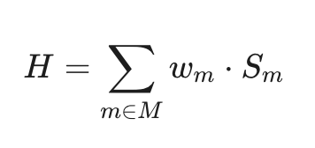
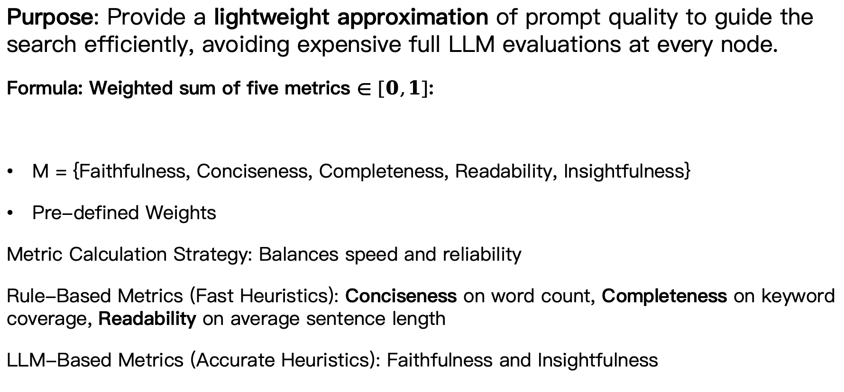
Heuristic Scoring Function
Purpose: Provide a lightweight approximation of prompt quality to guide the search efficiently, avoiding expensive full LLM evaluations at every node.
Formula: Weighted sum of five metrics $∈[0,1]$:
M = {Faithfulness, Conciseness, Completeness, Readability, Insightfulness}
Pre-defined Weights
Metric Calculation Strategy: Balances speed and reliability
Rule-Based Metrics (Fast Heuristics): Conciseness on word count, Completeness on keyword coverage, Readability on average sentence length
LLM-Based Metrics (Accurate Heuristics): Faithfulness and Insightfulness
Notes:
1. 从 root 开始，沿 UCB 选择最有潜力的节点
2. 对该节点执行 Add/Delete/Replace 扩展（ToT 思想展开）
3. 对新节点做启发式评估（快速）
4. 如果节点有潜力 → 做 LLM 全量评估（真实评分）
5. 把真实得分沿路径回溯更新
6. 最优节点 best_node 可能更新

Slide 22
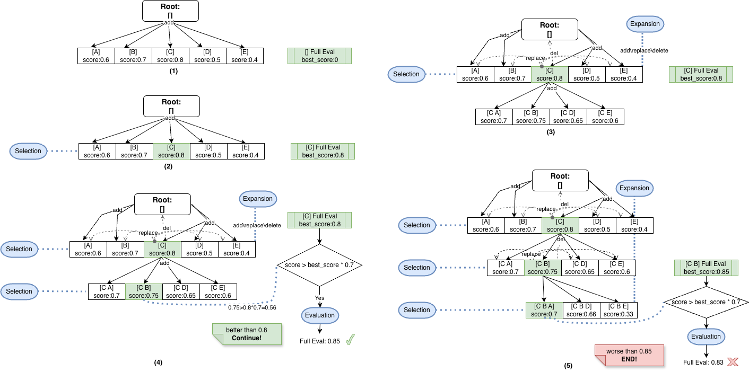
Given 5 non-conflict componments: [A B C D E]
Notes:
1. 从 root 开始，沿 UCB 选择最有潜力的节点
2. 对该节点执行 Add/Delete/Replace 扩展（ToT 思想展开）
3. 对新节点做启发式评估（快速）
4. 如果节点有潜力 → 做 LLM 全量评估（真实评分）
5. 把真实得分沿路径回溯更新
6. 最优节点 best_node 可能更新

Slide 23
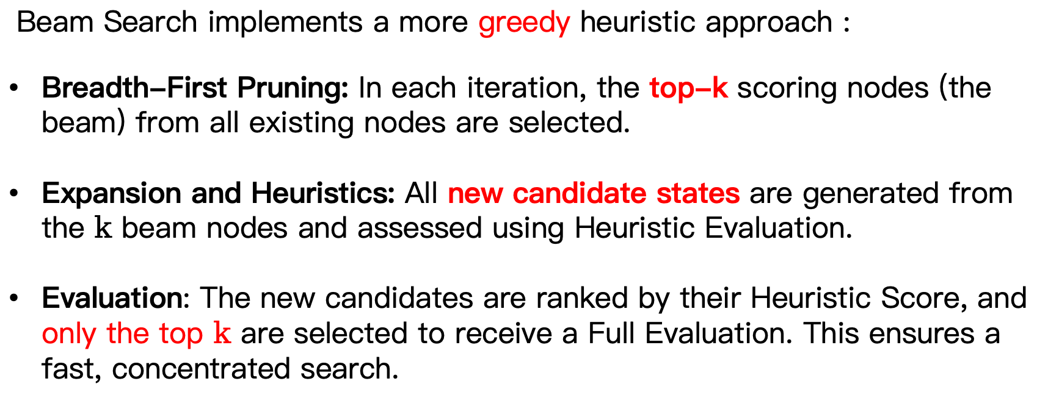
Beam Search
Beam Search implements a more greedy heuristic approach :
Breadth-First Pruning: In each iteration, the top-k scoring nodes (the beam) from all existing nodes are selected.
Expansion and Heuristics: All new candidate states are generated from the $k$ beam nodes and assessed using Heuristic Evaluation.
Evaluation: The new candidates are ranked by their Heuristic Score, and only the top $k$ are selected to receive a Full Evaluation. This ensures a fast, concentrated search.
Notes:
步骤更简单：
总是选择 top-k 节点作为 beam
扩展每个 beam 的候选 children
对最好的 candidates 做 full evaluation
更新 beam，循环迭代

Slide 24
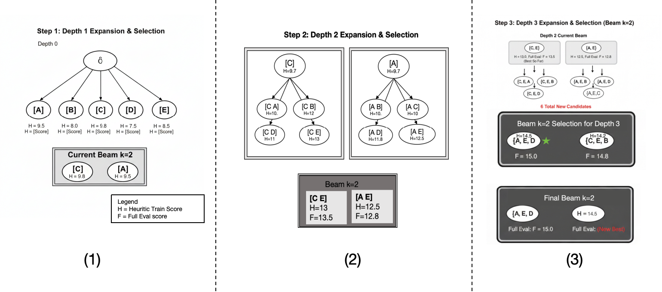
Given 5 non-conflict componments: [A B C D E]
Notes:
1. 从 root 开始，沿 UCB 选择最有潜力的节点
2. 对该节点执行 Add/Delete/Replace 扩展（ToT 思想展开）
3. 对新节点做启发式评估（快速）
4. 如果节点有潜力 → 做 LLM 全量评估（真实评分）
5. 把真实得分沿路径回溯更新
6. 最优节点 best_node 可能更新

Slide 25
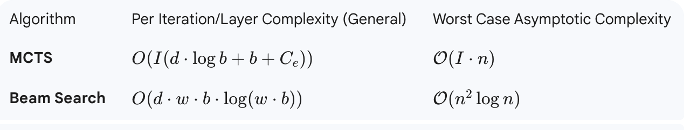
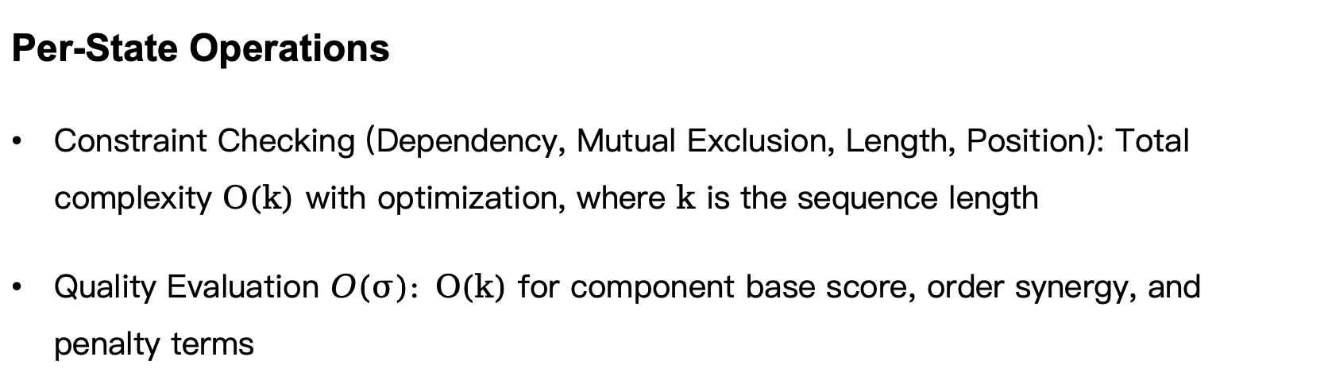
Complexity Analysis
Per-State Operations
Constraint Checking (Dependency, Mutual Exclusion, Length, Position): Total complexity $O(k)$ with optimization, where $k$ is the sequence length
Quality Evaluation$O(σ): O(k)$ for component base score, order synergy, and penalty terms

Slide 26
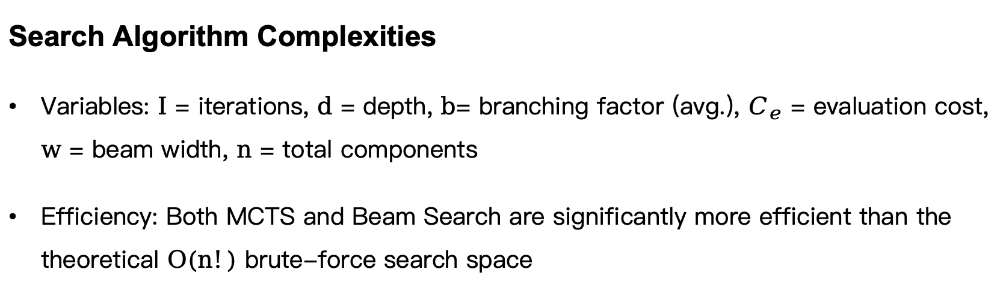
Complexity Analysis
Search Algorithm Complexities
Variables: $I$ = iterations, $d$ = depth, $b$= branching factor (avg.), $C_{e}$ = evaluation cost, $w$ = beam width, $n$ = total components
Efficiency: Both MCTS and Beam Search are significantly more efficient than the theoretical $O(n!)$ brute-force search space

Slide 27
04
Experimental Results and Discussion

Slide 28
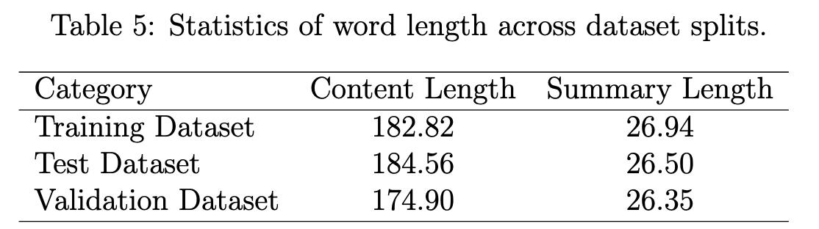
Experiments
Dataset → Summarization Task
Instead of complex formats (URLs, PDFs) or dialogue-style content。
A clean, plain-text dataset was manually constructed for the experiments.
Source:
Summarization：ICLR 2026 OpenReview platform
Prompt Components：Human designed 20 Entries

Slide 29
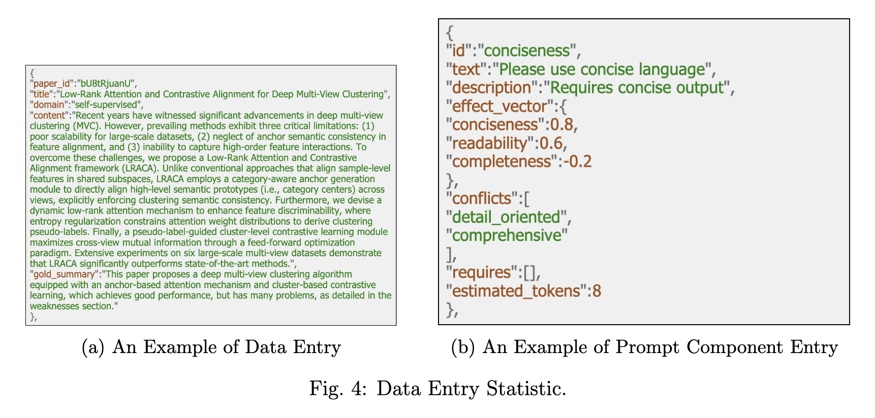
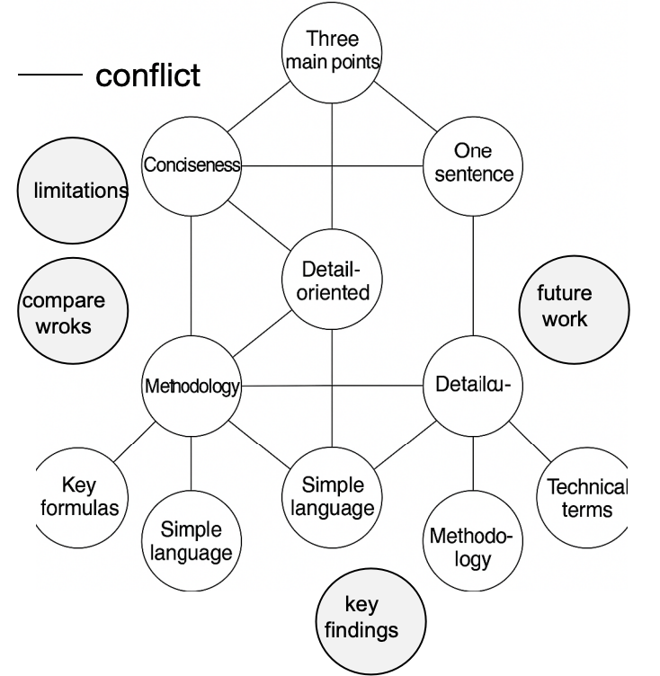

Slide 30
Setup
Models:
Base Model (for ToT Training): Qwen3-1.7B.
Scoring Model (Discriminator): Qwen3-8B
Baselines：
SimplePrompt: “Summary this paper”
DetailedPrompt: “A prompt asking for core content, methodology, and contributions”
StructuredPrompt: “A prompt asking to summarize from four aspects: background, methodology, experiments, and conclusions”
Metrics：
N-gram Static Metrics: ROUGE-2 F1 and ROUGE-L F1
Semantic Similarity Metrics: BERTScore F1 (using "bert-base-multilingual-cased").
LLM Evaluation Score: Heuristic Scoring

Slide 31
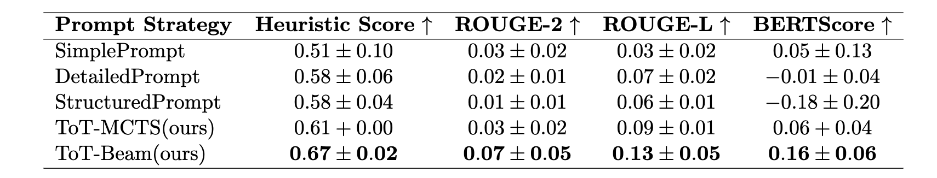
Experimental Results and Discussion
Overall Performance
ToT Prompt-Beam's Success: This strategy consistently achieved the highest scores across all reported metrics
MCTS vs. Beam Search:
ToTPrompt-MCTS < ToTPrompt-Beam
Notes:
ToT 各个指标上数值最高
且Beam 比 蒙特卡洛策略 更好

Slide 32
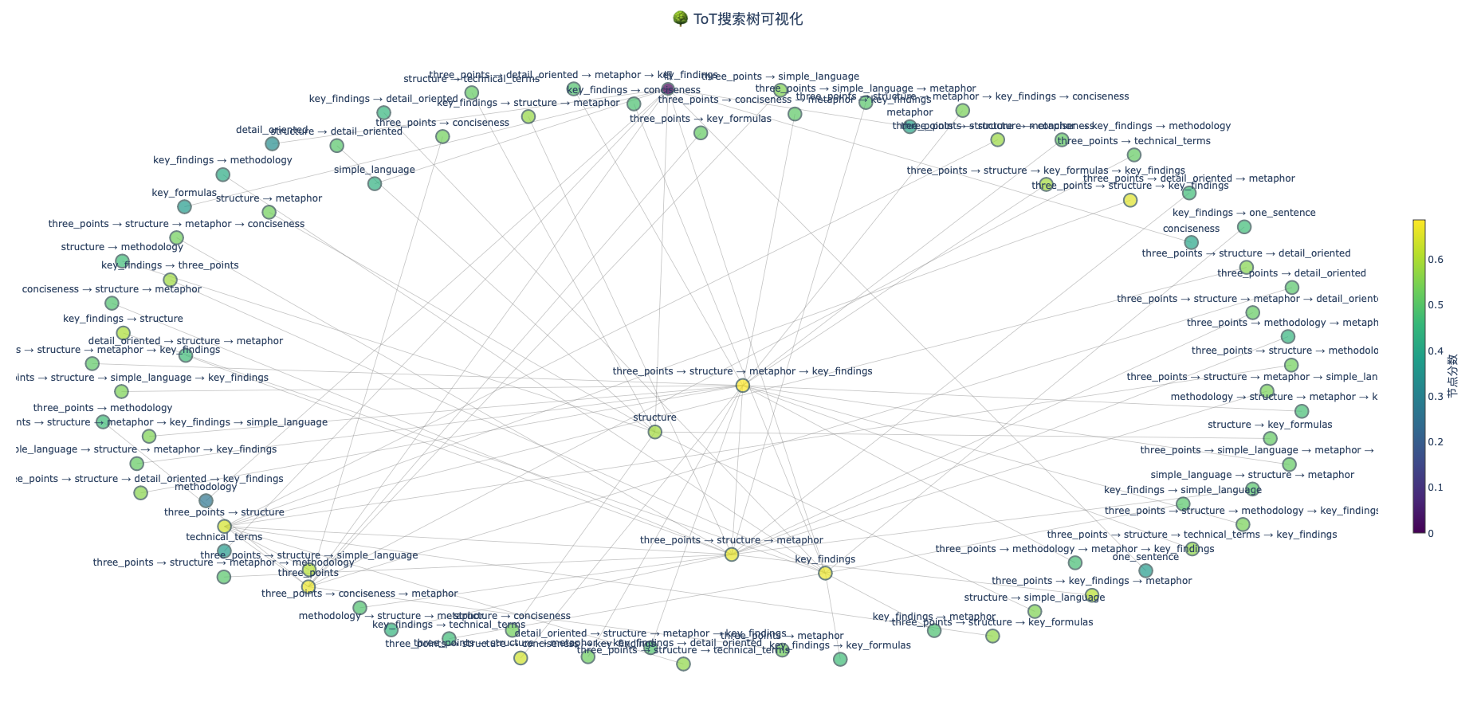
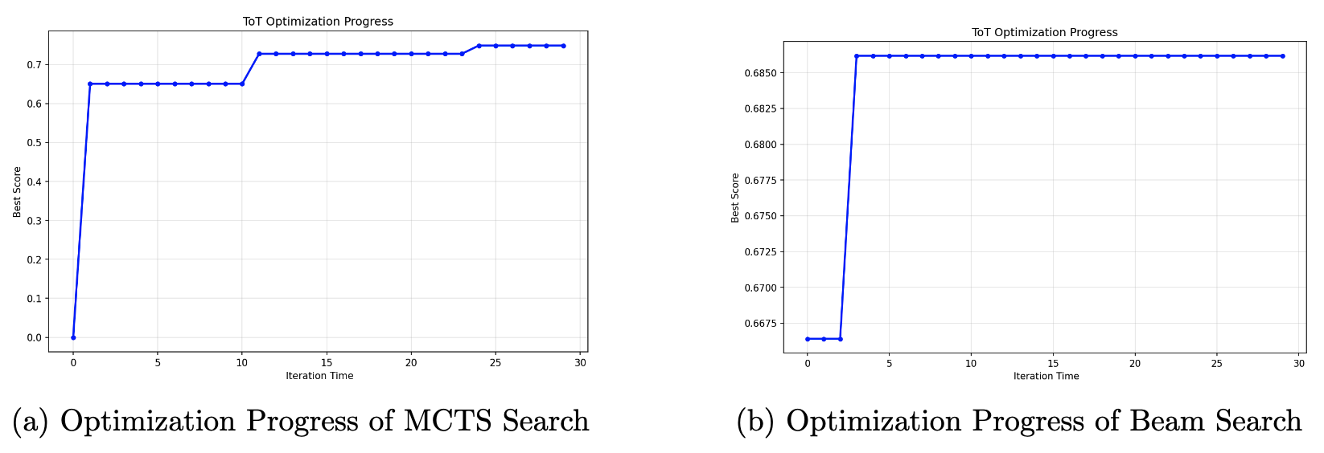
Convergence Analysis
Scores quickly converged in both strategies. Beam Search converged significantly faster than MCTS due to its greedy-like selection at each step
Potential Reason for Rapid Convergence
an insufficiently rich set of prompt components,
a small candidate set
a small training batch size leading to minimal score variation
Notes:
观察收敛速度发现 Beam很快就收敛了
查看beam tree 发现很多路径很短 也就是优化器很早的时候就达到局部最优，说往下搜索的过程构造的prompt 组合毫无意义。
原因可能是： 1.我们提供的 prompt components 不够多样化，很多重复语义的prompts
导致可组合prompt组合的整体信息量不够丰富
3.也可能是设置参与启发计算的数据量太小了。

Slide 33



Division of Lablor
Problem Background
Mathematical Modeling
Complexity Analysis
Method Design
Design Rationale
Zhao Zhao
Xiaoqi Qiu
Code&Expriments
Code&Dataset:
git@github.com:Siki-cloud/ToT_Optimizer_for_LLMSum.git

Slide 34

“
ToT-Prompt Optimization for LLM-based Automatic Summarization
“
Thank you
Reporter: Zhaozhao Xiaoqi Qiu
Date: 2025/12/10
Notes:
And here you have a glimpse into the future of transportation. I belived These emerging technologies will create a system that’s efficient, sustainable, and visually stunning. That’s all for my talk, thank you!

